Slide 1
How we made Configurable Pester Tests
for SQL Server
Rob Sewell, MVP, DBA
Chrissy LeMaire, MVP, DBA

Slide 2

Rob Sewell
Sewells Consulting Limited
PowerShell Automator, PowerShell Trainer, Database DevOps
MVP, Speaker and Organizer
Half a Best Speaker!!, PowerShell and SQL user groups, national and international events
Consultant, Sewells Consulting Ltd
dbatools dbareports dbachecks
Loves Pester. Always available for help via the usual social media channels
/in/robsewellsqldba
@sqldbawithbeard
robsewell.info
Notes:
This is Rob He runs his own company providing PowerShell magic, PowerShell Training and Database DevOps consultancy he’s a speaker and organiser for SQL South West, SQL Saturday Exeter, PSDayUK, PSConf.eu, PSConfasia and conference volunteer at SQL Bits

Slide 3

Chrissy LeMaire
SQL Data Pro – Since 1999
DBA, Developer and Architect
PowerShell MVP – Since 2015
Most PowerShell work revolves around SQL Server with a bit of VMware & SharePoint
Sr. Systems Engineer
GDIT @ NATO Special Ops HQ
PASS DevOps Virtual Chapter
Co-lead
/in/chrissylemaire
@cl
netnerds.net

Slide 4
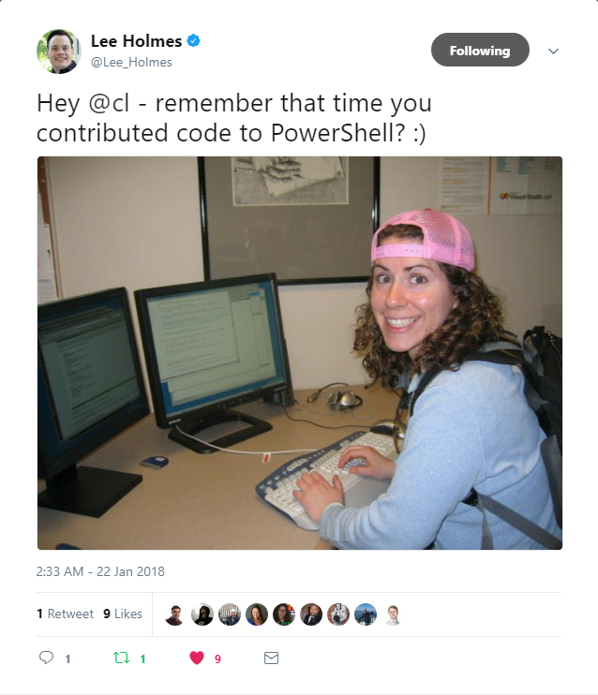
PowerShell since 2005
❤️

Slide 5
Agenda
Background
Goals & Challenges
Solutions
Intro to module
Demo

Slide 6

Background

Slide 7
dbatools
Community module founded by Chrissy
Over 100 contributors
5 billion commands to work with SQL Server (no point putting an actual number in here it will change!!)
Many commands to get information or check best practices
Rob needed to validate estates at work
Wrote Pester tests using dbatools
More than a year discussing wondering the best way to enable configuration

Slide 8
Challenges & Goals

Slide 9
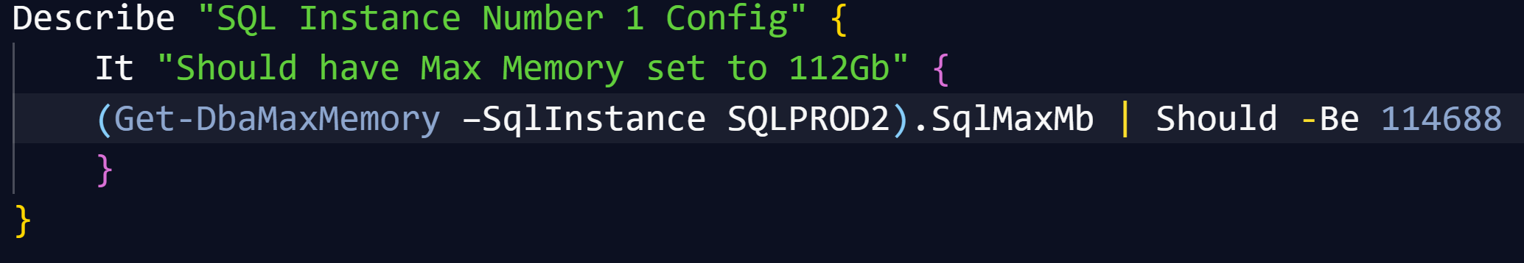
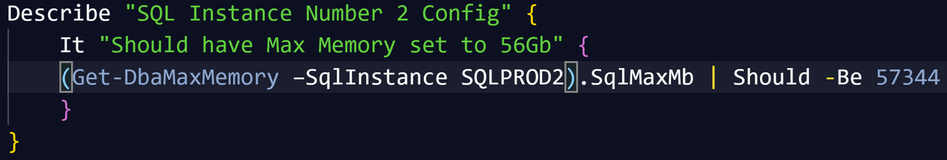
Main Challenge - Configuration
Writing Pester Tests for one SQL instance is easy
Writing slightly different Pester Tests for slightly different instances is copy and paste
It is possible to parameterize Pester tests (but not so easy to say!)

Slide 10
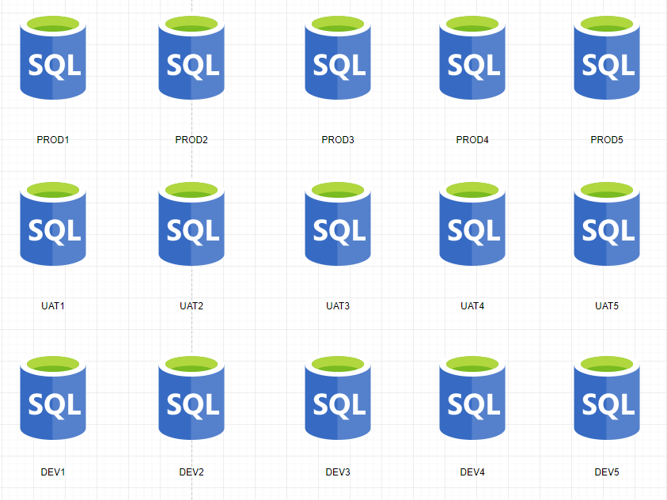
Main Challenge - Configuration
We wanted to be able to Pester test a SQL environment like Production, UAT, DEV - horizontal
We wanted to be able to Pester test a whole applications SQL environments – vertical
We wanted to be able to Pester test the SQL estate for a solution – block

Slide 11
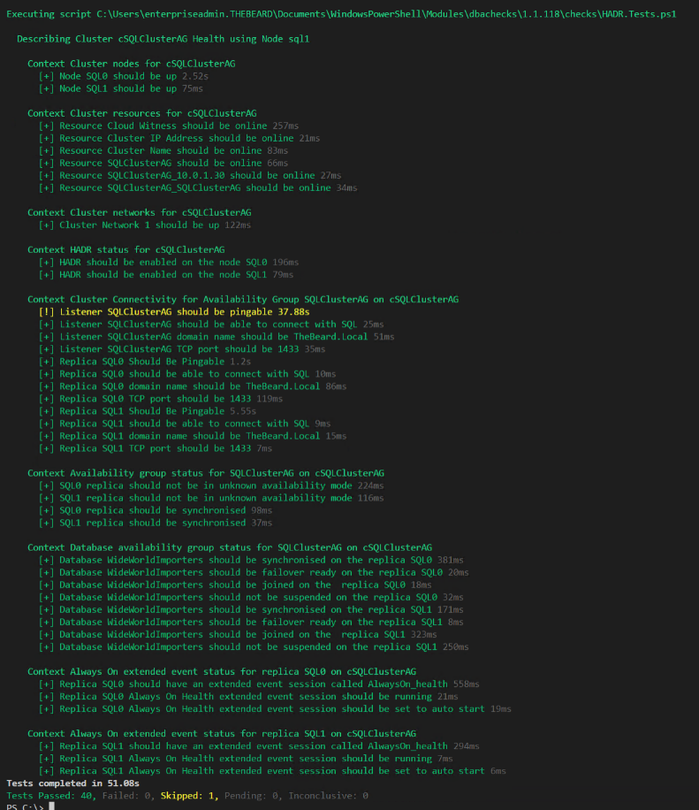
Challenge - Output
DBAs may need output instantly

Slide 12
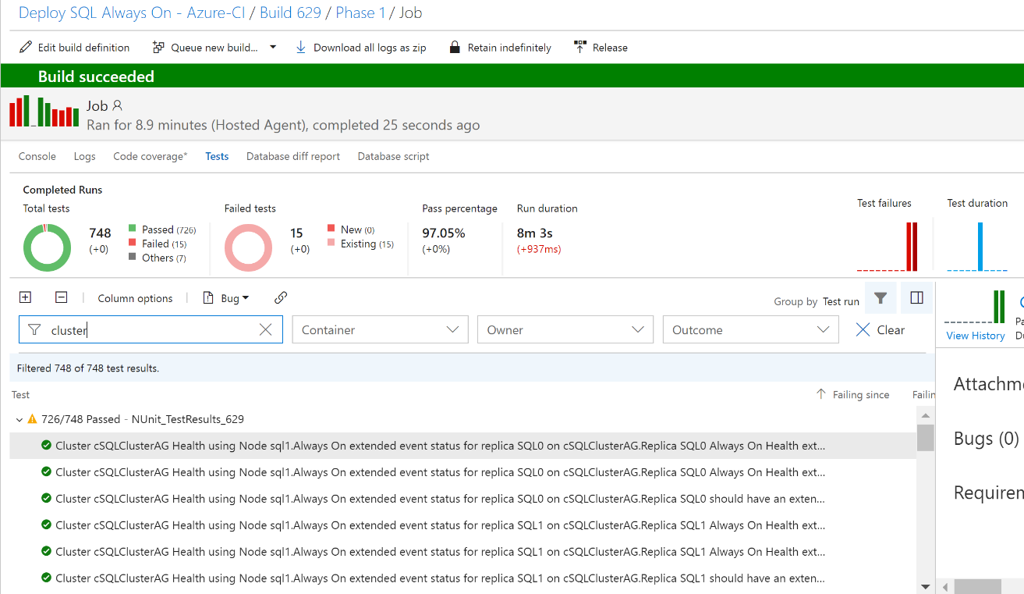
Challenge - Output
DBAs may want to automate and integrate with other solutions (DevOps, Daily Checks, Incident Response, Maintenance Windows)

Slide 13
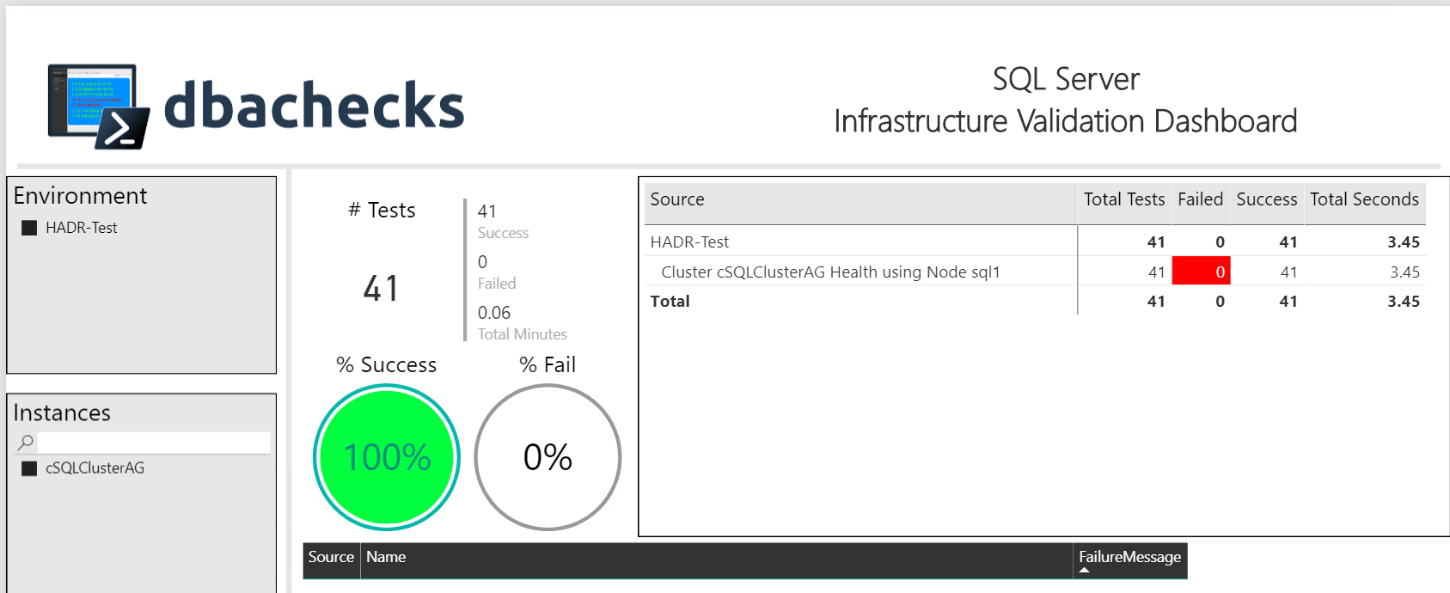
Challenge - Output
Management want output they understand

Slide 14
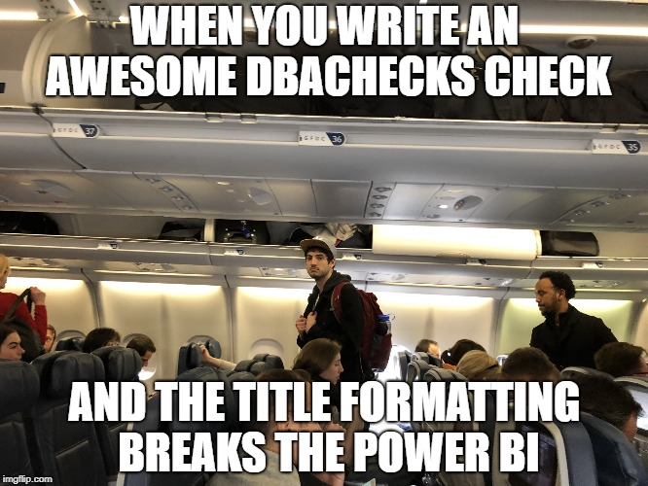
Challenge - Output
The Power Bi template requires a specific title configuration

Slide 15
Challenge – User Simplicity
End Users
Need simplicity to enable easy adoption
Need index for Checks
Need index for Configuration
Simplified output options
File system access to work across many differing user environments and permissions

Slide 16
Goals
Create redistributable, easily configurable Pester tests using industry leaders checklists
Enable output to suit the requirements of different types of end users human and machine
Capability to provide response/resolution ?

Slide 17

Solution

Slide 18
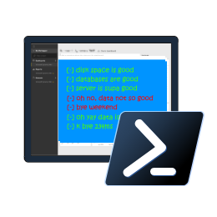
dbachecks
Notes:
# To get started
Install-Module Pester -SkipPublisherCheck
Update-Module Pester -Force
Import-Module Pester -Force
# Perform a basic check
Invoke-DbcCheck -SqlInstance localhost\sql2017 -Checks SuspectPage, LastBackup
# How do we know which checks exist and if we should specify SqlInstance or ComputerName?
Get-DbcCheck | Out-GridView
Get-DbcCheck *disk*
Invoke-DbcCheck -SqlInstance localhost\sql2017 -Checks ValidDatabaseOwner
# Make a server list
$servers = "localhost\sql2017","localhost\sql2016"
$servers = Get-DbaRegisteredServer -SqlInstance localhost\sql2017
$servers = Get-Content C:\scripts\servers.txt
$servers = Get-ADComputer -Filter "name -like '*sql*'"
# Run statically - set once
Set-DbcConfig -Name app.sqlinstance -Value $servers
Set-DbcConfig -Name app.computername -Value localhost
Invoke-DbcCheck -Checks SuspectPage, LastBackup
Invoke-DbcCheck -Checks DiskCapacity
# Or Dynamically
Invoke-DbcCheck -SqlInstance $sqlservers -Checks SuspectPage, LastBackup
Invoke-DbcCheck -ComputerName $computers -Checks DiskCapacity
# How do we know which configs exist?
Get-DbcConfig | Out-GridView
# A little more advanced which runs all Database Checks except backups - also passes an alternative credential
Invoke-DbcCheck -Check Database -ExcludeCheck Backup -SqlInstance localhost\sql2016 -SqlCredential (Get-Credential sqladmin)
# Run checks and export its JSON
Invoke-DbcCheck -SqlInstance localhost\sql2017 -Checks SuspectPage, LastBackup -Show Summary -PassThru |
Update-DbcPowerBiDataSource
# You can also split it up by environment
Invoke-DbcCheck -SqlInstance $prod -Checks LastBackup -Show Summary -PassThru | Update-DbcPowerBiDataSource -Environment Production
Invoke-DbcCheck -SqlInstance $dev -Checks LastBackup -Show Summary -PassThru | Update-DbcPowerBiDataSource -Environment Development
Invoke-DbcCheck -SqlInstance $test -Checks LastBackup -Show Summary -PassThru | Update-DbcPowerBiDataSource -Environment Test
# Launch Power BI then hit refresh
Start-DbcPowerBi
# Prefer email? Also easy:
Invoke-DbcCheck -SqlInstance localhost\sql2017 -Checks SuspectPage, LastBackup -OutputFormat NUnitXml -PassThru |
Send-DbcMailMessage -To clemaire@dbatools.io -From nobody@dbachecks.io -SmtpServer localhost
# Have specific requirements and want to add your own checks? Add your own repo! *
Set-DbcConfig -Name app.checkrepos -Value C:\temp\checks -Append
# What does our repo look like?
Invoke-Item "$(Split-Path (Get-Module dbachecks).Path)\checks"
Start-Process https://dbachecks.io/wiki
# Set a global, persistent credential
Set-DbcConfig -Name app.sqlcredential -Value (Get-Credential sqladmin)

Slide 19
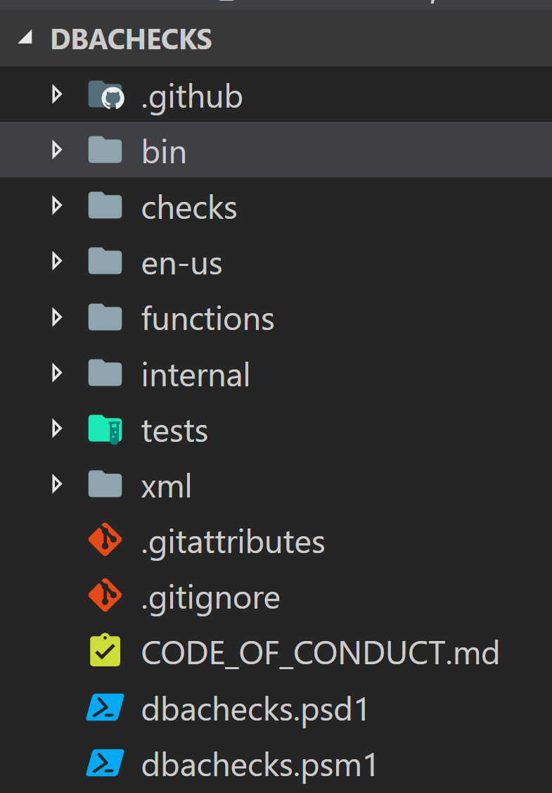
dbachecks
Notes:
Describe whats in the folders

Slide 20
Dbachecks – Configuration
Using PSFramework to create configuration items
Stored in registry
Set-PSFConfig -Module dbachecks -Name app.sqlinstance -Value $null -Initialize -Description "List of SQL Server instances"

Slide 21
Dbachecks – Configuration
Enabling Users to set configuration
Over 120 configuration items available right now (Apr 2018)
Set-DbcConfig -Name app.sqlinstance -Value sql2016, sql2017
Set-DbcConfig -Name app.sqlinstance -Value sqlcluster –Append

Slide 22
Dbachecks – Configuration
Using Configuration in Pester Tests
Describe "Network Latency" -Tag NetworkLatency, Connectivity, $filename {
$max = Get-DbcConfigValue policy.network.latencymaxms
@(Get-Instance).ForEach{
Context "Testing Network Latency on $psitem" {
@(Test-DbaNetworkLatency -SqlInstance $psitem).ForEach{
It "network latency Should Be less than $max ms on $($psitem.SqlInstance)" {
$psitem.Average.TotalMilliseconds | Should -BeLessThan $max -Because 'You dont want to be waiting on the network'
}
}
}

Slide 23
Dbachecks – Configuration
Export and Import the config
Export-DbcConfig -Path C:\Users\Beard\git\PesterConfigs\Application1_PROD.json
Export-DbcConfig -Path C:\Users\Hair\git\PesterConfigs\Client1_System2_Quick.json
Import-DbcConfig -Path Git:\PesterConfigs\Application1_PROD.json
Invoke-DbcCheck
Import-DbcConfig -Path Git:\PesterConfigs\Client1_System2_Quick.json
Invoke-DbcCheck

Slide 24
Dbachecks – User Simplicity
End user needs index
Get-DbcCheck
Get-DbcConfig
Get-DbcTagCollection

Slide 25
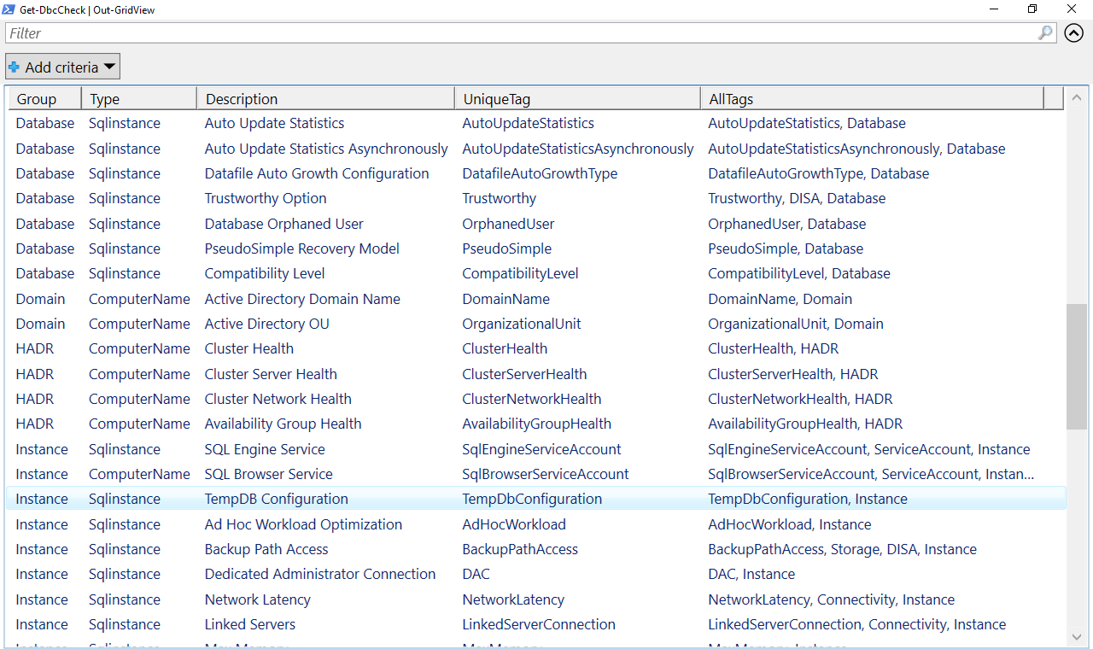
Dbachecks – User Simplicity

Slide 26
Dbachecks – User Simplicity
Simplified output
Send-DbcMailMessage
Update-DbcPowerBiDataSource
Start-DbcPowerBi

Slide 27
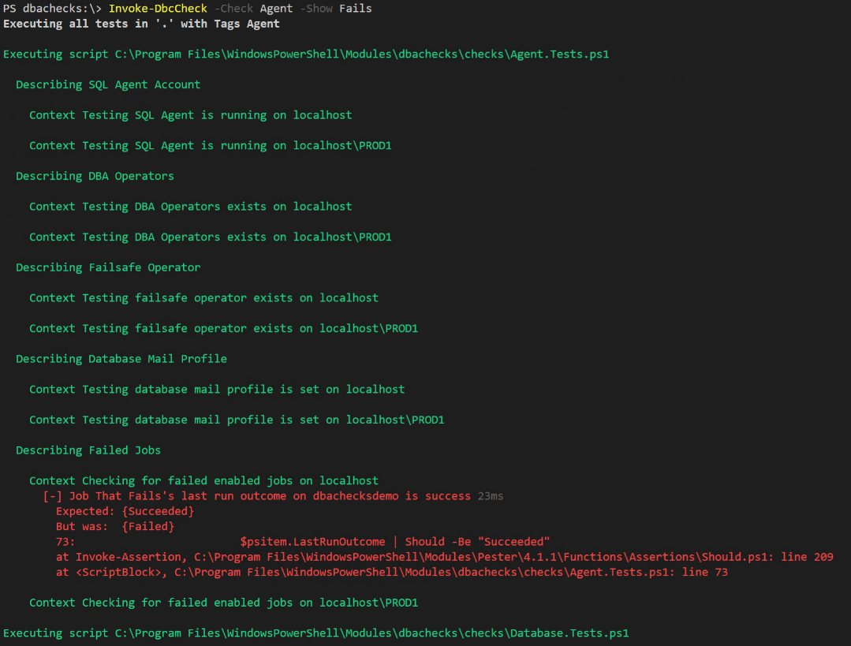
Dbachecks – Output
Invoke-DbcCheck wraps Invoke-Pester so results available at command-line
Invoke-DbcCheck -Show Fails

Slide 28
Dbachecks – Output
Invoke-DbcCheck can output XML (Just like Invoke-Pester can)
Import-DbcConfig -Path $(System.WorkingDirectory)\PesterConfigs\Application.json
Invoke-DbcCheck -Show Summary -PassThru -OutputFile $(System.WorkingDirectory)\Test-Results.xml
Notes:
$(System.WorkingDirectory) is a VSTS build variable to show you can then publish the results in VSTS

Slide 29
Dbachecks – Output
Invoke-DbcCheck for multiple scenarios all in one PowerBi ☺
Import-DbcConfig –path Git:\PesterConfigs\Application1_PROD.json
Invoke-DbcCheck -Show Summary -PassThru | Update-DbcPowerBiDataSource –Environment App1_Prod
Import-DbcConfig –path Git:\PesterConfigs\Application2_PROD.json
Invoke-DbcCheck -Show Summary -PassThru | Update-DbcPowerBiDataSource –Environment App2_Prod
Import-DbcConfig –path Git:\PesterConfigs\Application3_PROD.json
Invoke-DbcCheck -Show Summary -PassThru | Update-DbcPowerBiDataSource –Environment App3_Prod
Start-DbcPowerbi

Slide 30

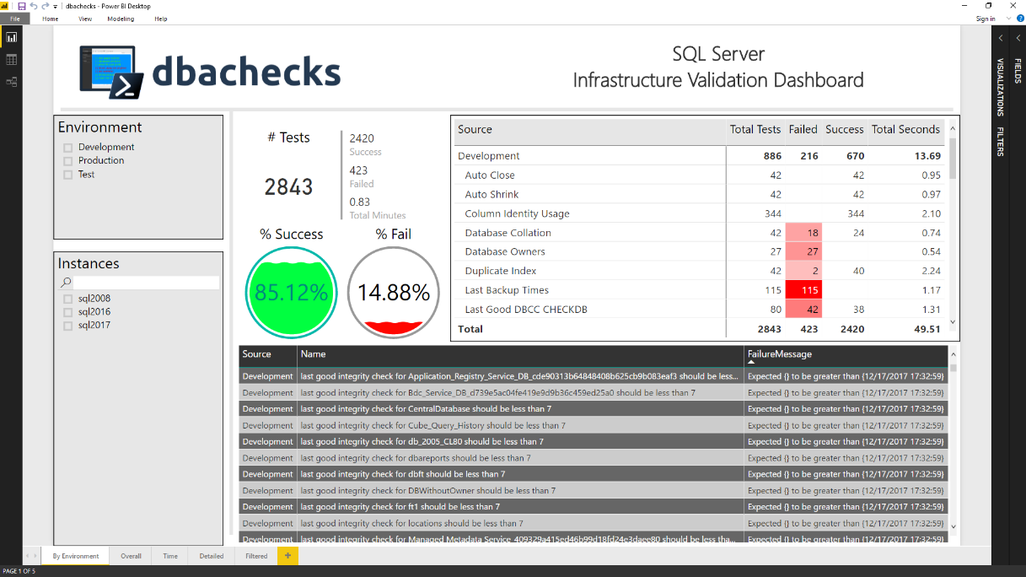
Dashboards galore
We use C:\Windows\Temp\dbachecks to simplify enabling instant refreshes

Slide 31
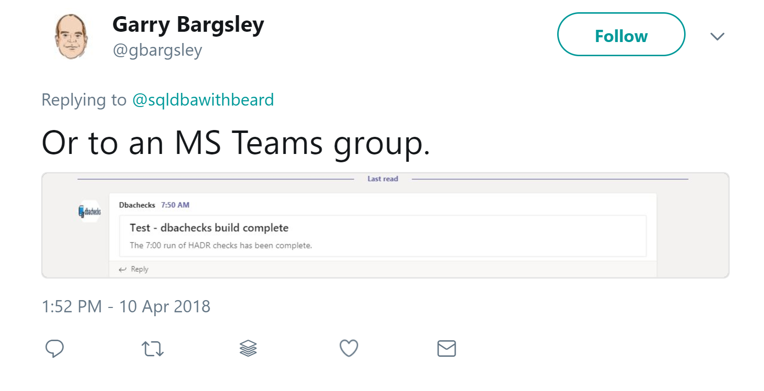
Dbachecks – What we didn’t do
Enable Output to
Database
MS Teams
Slack
Twitter
JIRA
Because it’s PowerShell so | ANYTHING
Invoke-DbcCheck –PassThru

Slide 32
demo time!
Notes:
# To get started
Install-Module Pester -SkipPublisherCheck
Update-Module Pester -Force
Import-Module Pester -Force
# Perform a basic check
Invoke-DbcCheck -SqlInstance localhost\sql2017 -Checks SuspectPage, LastBackup
# How do we know which checks exist and if we should specify SqlInstance or ComputerName?
Get-DbcCheck | Out-GridView
Get-DbcCheck *disk*
Invoke-DbcCheck -SqlInstance localhost\sql2017 -Checks ValidDatabaseOwner
# Make a server list
$servers = "localhost\sql2017","localhost\sql2016"
$servers = Get-DbaRegisteredServer -SqlInstance localhost\sql2017
$servers = Get-Content C:\scripts\servers.txt
$servers = Get-ADComputer -Filter "name -like '*sql*'"
# Run statically - set once
Set-DbcConfig -Name app.sqlinstance -Value $servers
Set-DbcConfig -Name app.computername -Value localhost
Invoke-DbcCheck -Checks SuspectPage, LastBackup
Invoke-DbcCheck -Checks DiskCapacity
# Or Dynamically
Invoke-DbcCheck -SqlInstance $sqlservers -Checks SuspectPage, LastBackup
Invoke-DbcCheck -ComputerName $computers -Checks DiskCapacity
# How do we know which configs exist?
Get-DbcConfig | Out-GridView
# A little more advanced which runs all Database Checks except backups - also passes an alternative credential
Invoke-DbcCheck -Check Database -ExcludeCheck Backup -SqlInstance localhost\sql2016 -SqlCredential (Get-Credential sqladmin)
# Run checks and export its JSON
Invoke-DbcCheck -SqlInstance localhost\sql2017 -Checks SuspectPage, LastBackup -Show Summary -PassThru |
Update-DbcPowerBiDataSource
# You can also split it up by environment
Invoke-DbcCheck -SqlInstance $prod -Checks LastBackup -Show Summary -PassThru | Update-DbcPowerBiDataSource -Environment Production
Invoke-DbcCheck -SqlInstance $dev -Checks LastBackup -Show Summary -PassThru | Update-DbcPowerBiDataSource -Environment Development
Invoke-DbcCheck -SqlInstance $test -Checks LastBackup -Show Summary -PassThru | Update-DbcPowerBiDataSource -Environment Test
# Launch Power BI then hit refresh
Start-DbcPowerBi
# Prefer email? Also easy:
Invoke-DbcCheck -SqlInstance localhost\sql2017 -Checks SuspectPage, LastBackup -OutputFormat NUnitXml -PassThru |
Send-DbcMailMessage -To clemaire@dbatools.io -From nobody@dbachecks.io -SmtpServer localhost
# Have specific requirements and want to add your own checks? Add your own repo! *
Set-DbcConfig -Name app.checkrepos -Value C:\temp\checks -Append
# What does our repo look like?
Invoke-Item "$(Split-Path (Get-Module dbachecks).Path)\checks"
Start-Process https://dbachecks.io/wiki
# Set a global, persistent credential
Set-DbcConfig -Name app.sqlcredential -Value (Get-Credential sqladmin)

Slide 33
questions

Slide 34
Blog posts & Twitter
dbachecks.io/intro
dbachecks.io/deepdive
dbachecks.io/blog
dbachecks.io/twitter

Slide 35
thank you!
Notes:
# To get started
Install-Module Pester -SkipPublisherCheck
Update-Module Pester -Force
Import-Module Pester -Force
# Perform a basic check
Invoke-DbcCheck -SqlInstance localhost\sql2017 -Checks SuspectPage, LastBackup
# How do we know which checks exist and if we should specify SqlInstance or ComputerName?
Get-DbcCheck | Out-GridView
Get-DbcCheck *disk*
Invoke-DbcCheck -SqlInstance localhost\sql2017 -Checks ValidDatabaseOwner
# Make a server list
$servers = "localhost\sql2017","localhost\sql2016"
$servers = Get-DbaRegisteredServer -SqlInstance localhost\sql2017
$servers = Get-Content C:\scripts\servers.txt
$servers = Get-ADComputer -Filter "name -like '*sql*'"
# Run statically - set once
Set-DbcConfig -Name app.sqlinstance -Value $servers
Set-DbcConfig -Name app.computername -Value localhost
Invoke-DbcCheck -Checks SuspectPage, LastBackup
Invoke-DbcCheck -Checks DiskCapacity
# Or Dynamically
Invoke-DbcCheck -SqlInstance $sqlservers -Checks SuspectPage, LastBackup
Invoke-DbcCheck -ComputerName $computers -Checks DiskCapacity
# How do we know which configs exist?
Get-DbcConfig | Out-GridView
# A little more advanced which runs all Database Checks except backups - also passes an alternative credential
Invoke-DbcCheck -Check Database -ExcludeCheck Backup -SqlInstance localhost\sql2016 -SqlCredential (Get-Credential sqladmin)
# Run checks and export its JSON
Invoke-DbcCheck -SqlInstance localhost\sql2017 -Checks SuspectPage, LastBackup -Show Summary -PassThru |
Update-DbcPowerBiDataSource
# You can also split it up by environment
Invoke-DbcCheck -SqlInstance $prod -Checks LastBackup -Show Summary -PassThru | Update-DbcPowerBiDataSource -Environment Production
Invoke-DbcCheck -SqlInstance $dev -Checks LastBackup -Show Summary -PassThru | Update-DbcPowerBiDataSource -Environment Development
Invoke-DbcCheck -SqlInstance $test -Checks LastBackup -Show Summary -PassThru | Update-DbcPowerBiDataSource -Environment Test
# Launch Power BI then hit refresh
Start-DbcPowerBi
# Prefer email? Also easy:
Invoke-DbcCheck -SqlInstance localhost\sql2017 -Checks SuspectPage, LastBackup -OutputFormat NUnitXml -PassThru |
Send-DbcMailMessage -To clemaire@dbatools.io -From nobody@dbachecks.io -SmtpServer localhost
# Have specific requirements and want to add your own checks? Add your own repo! *
Set-DbcConfig -Name app.checkrepos -Value C:\temp\checks -Append
# What does our repo look like?
Invoke-Item "$(Split-Path (Get-Module dbachecks).Path)\checks"
Start-Process https://dbachecks.io/wiki
# Set a global, persistent credential
Set-DbcConfig -Name app.sqlcredential -Value (Get-Credential sqladmin)

Slide 36
Install is easy
POWERSHELL GALLERY
Install-Module dbachecks
Install-Module dbachecks –Scope CurrentUser
* Automatically installs required modules

Slide 37

Join our Slack channel
Invite yourself to Slack
dbatools.io/slack
Join #dbachecks and #dbatools
Ask questions, possibly get answers in real time ;)

Slide 38
SQL Server
Pester
❤️

